Slide 1

Solution of Linear Equations
Lianna Santiago-Conty, Alonso Gutierrez, Angelo Scaria, Nicole Stanfill, Nicholas Riley, Andrew Roig
University of Central Florida
12/07/2020

Slide 2
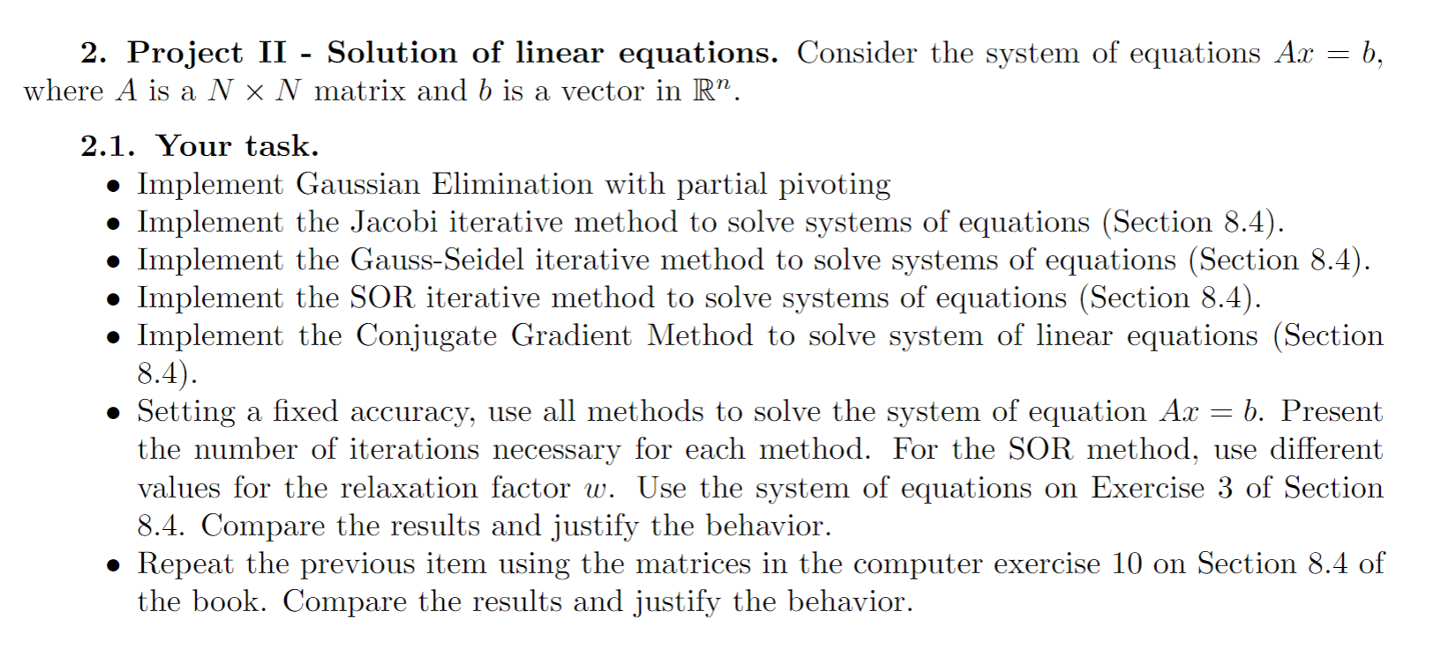
Deliverables
For this project, our goals are to discuss the five methods to solve a series of linear equations. We are then challenged to test if all methods can accurately and efficiently be utilized to get the same results.

Slide 3


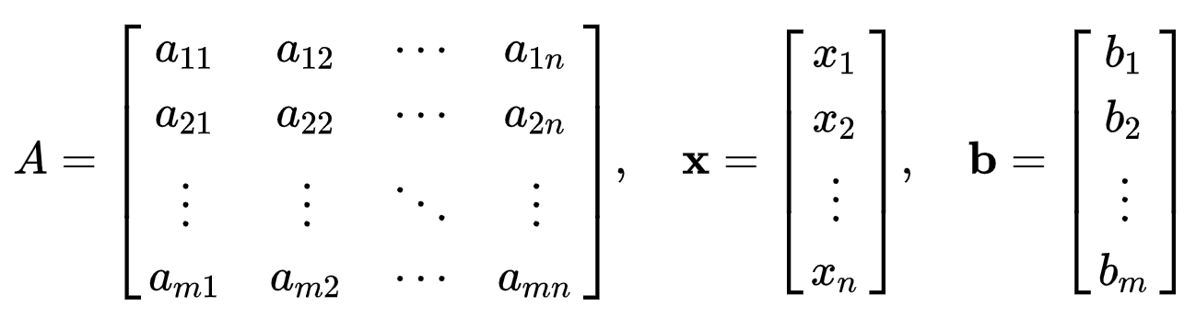
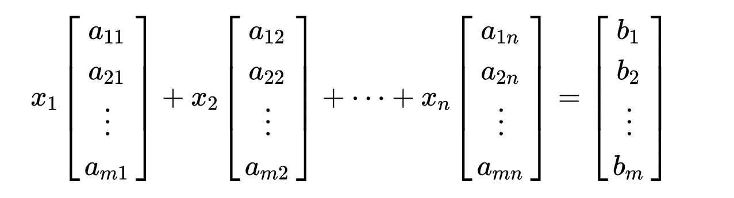
System of Linear Equations
A system of linear equations is a collection of one or more linear equations involving the same set of variables.
A common way to solve a linear system of equations is by putting it in matrix form (Ax=b)

Slide 4
Five Methods of Implementation
Gaussian Elimination with partial pivoting
Jacobi iterative Method
Gauss-Seidel iterative method
Successive Overrelaxation (SOR) method
Conjugate Gradient method

Slide 5
Gaussian Elimination Method

Slide 6
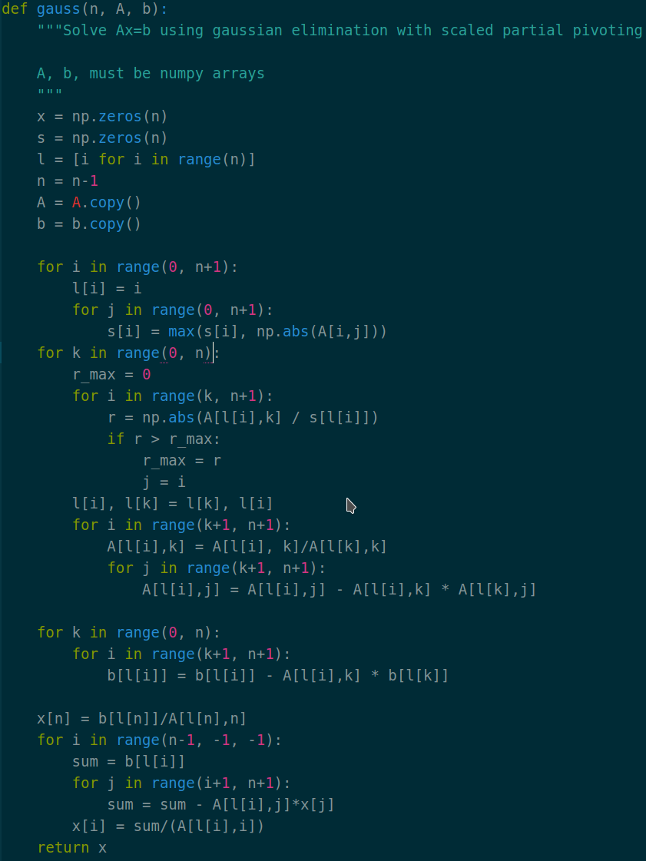
Gaussian Elimination Method Code

Slide 7

Jacobi Iterative Method

Slide 8
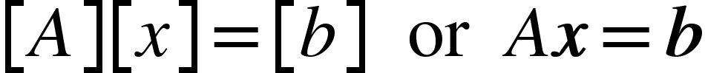
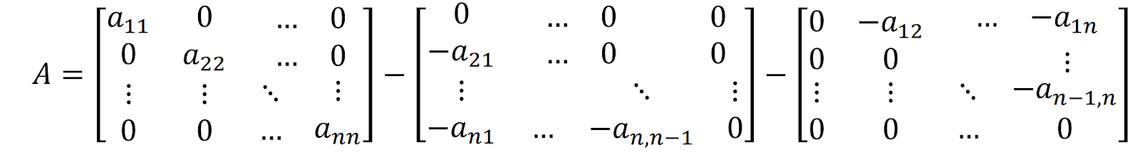
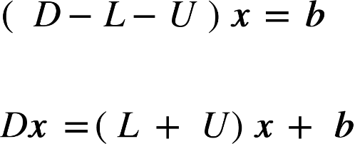
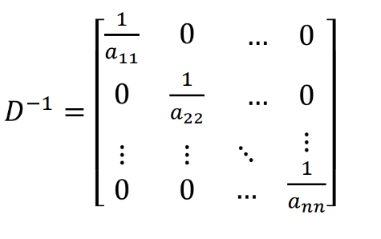
Jacobi Iterative Method
How we Use this Method…
The process iterates by solving the diagonal elements of the matrices until it converges

Slide 9
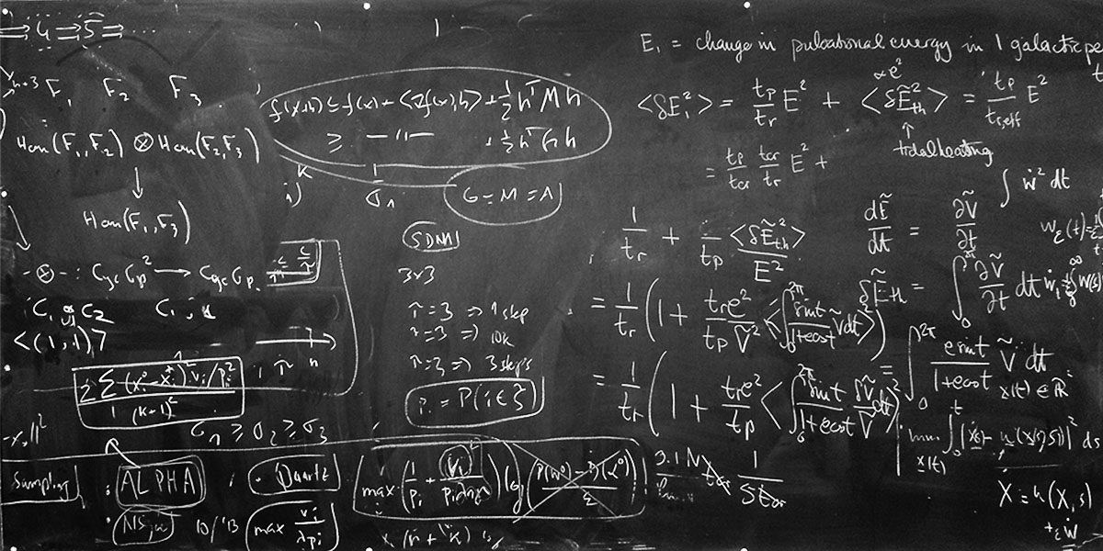
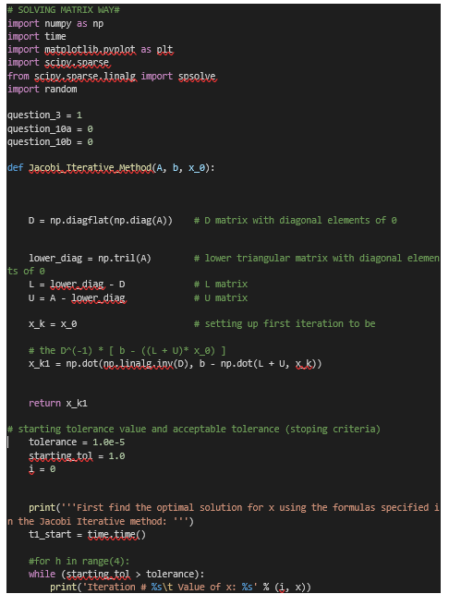
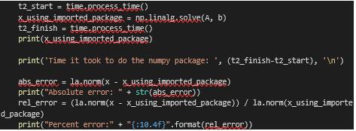
Jacobi Iterative Method Code

Slide 10
Gauss-Seidel Iterative Method

Slide 11
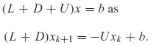
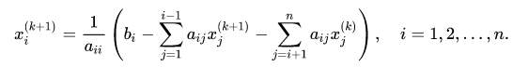
Gauss-Seidel Iterative Method
Uses the most recently updated values of the unknown at each step, even if the updating occurs in the current step
How we Use this Method…

Slide 12
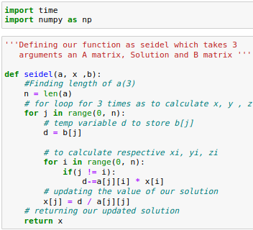
Gauss-Seidel Iterative Method Code

Slide 13
SOR Iterative Method

Slide 14
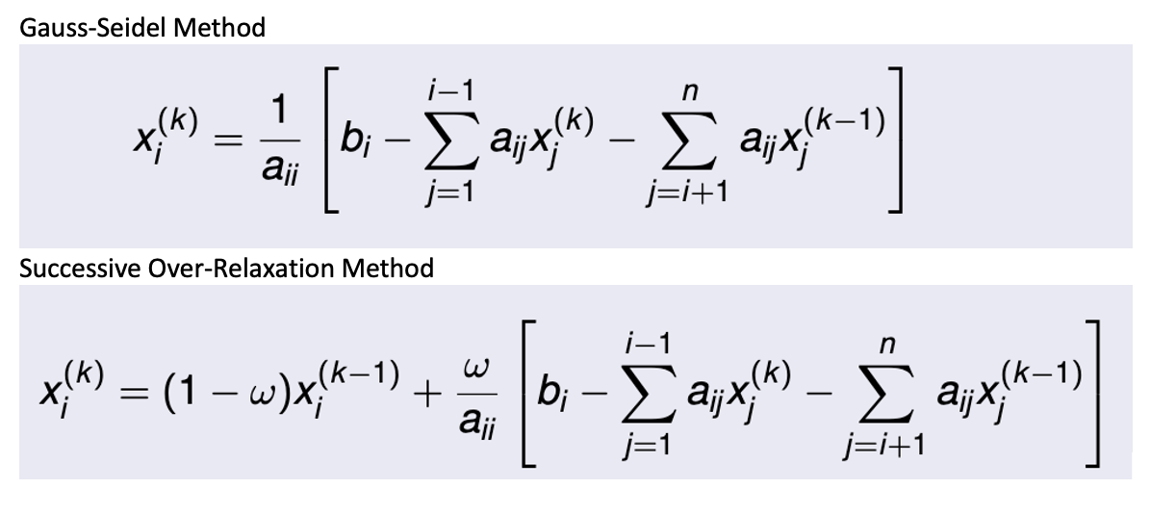
SOR Iterative Method How we Use this Method…
Stands for Successive Over-Relaxation
Utilizes a relaxation parameter, ω, to form a weighted average between the previous Gauss-Seidel iterate and the current Gauss-Seidel iterate for each iteration

Slide 15
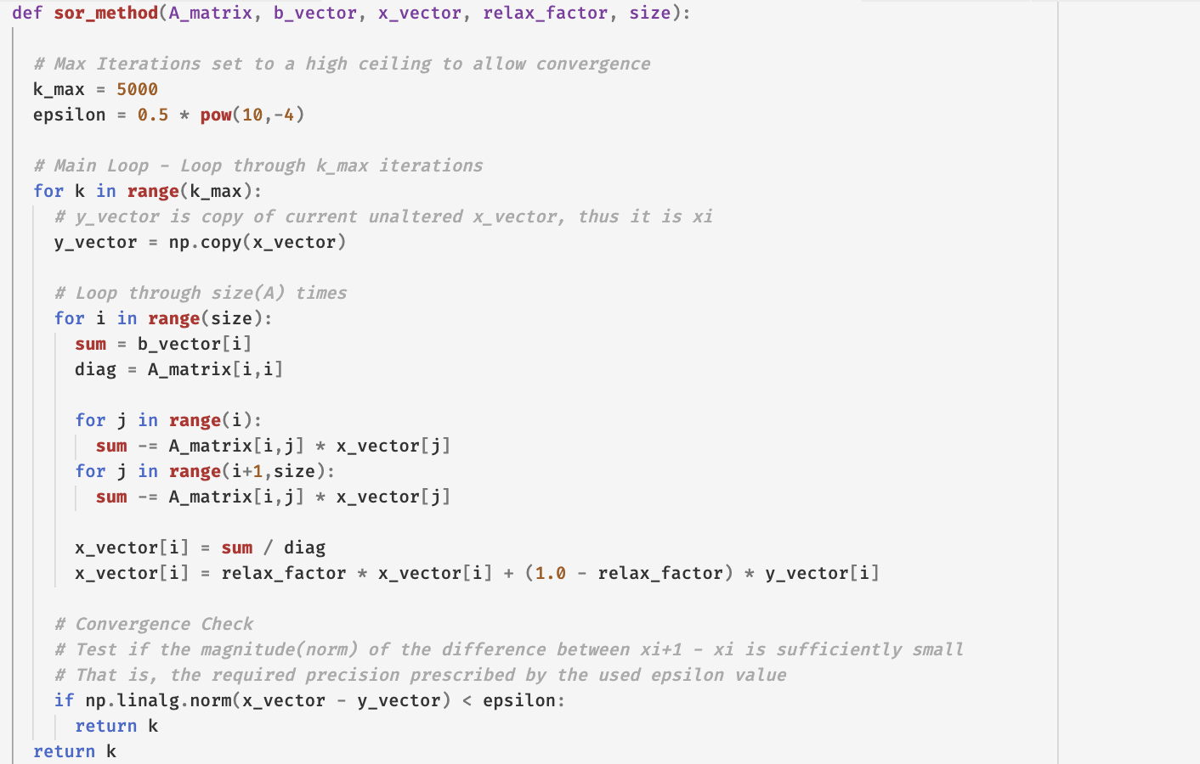
SOR Iterative Method Code

Slide 16
Conjugate Gradient Method

Slide 17
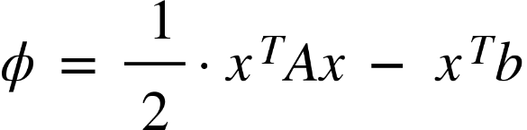
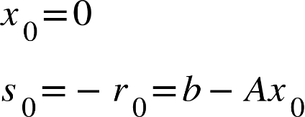
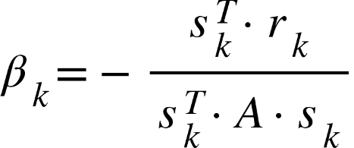
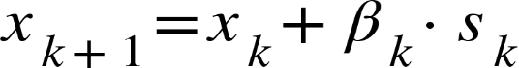
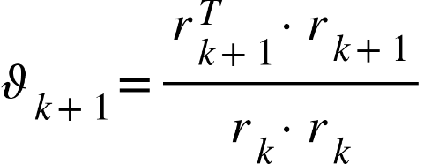
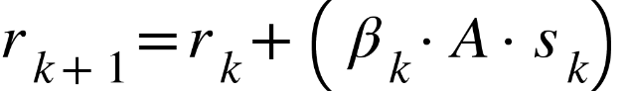
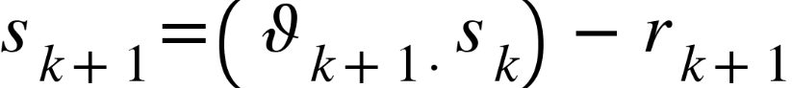
Conjugate Gradient Method
Used where the A matrix is symmetric and positive definite
How we Use this Method…

Slide 18
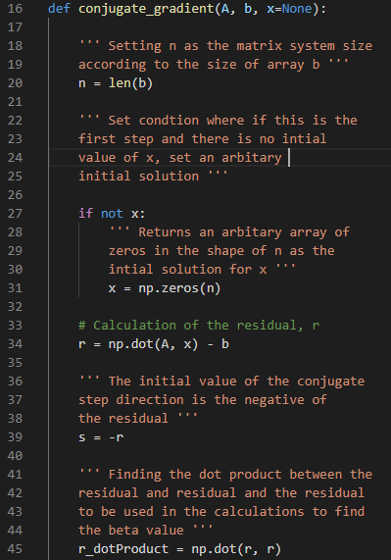
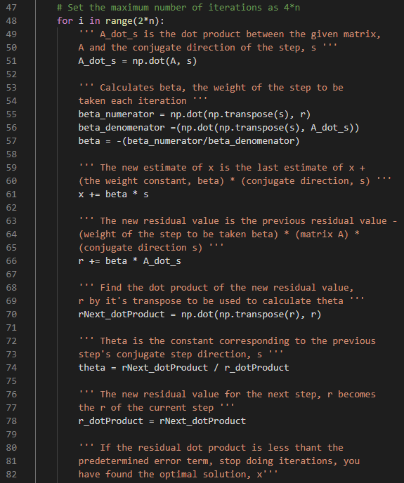
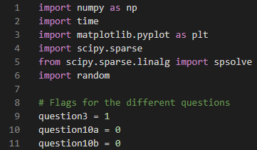
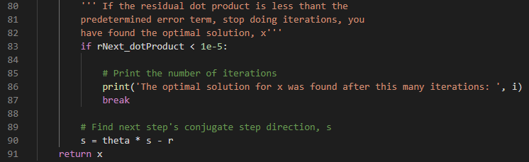
Conjugate Gradient Method Code

Slide 19
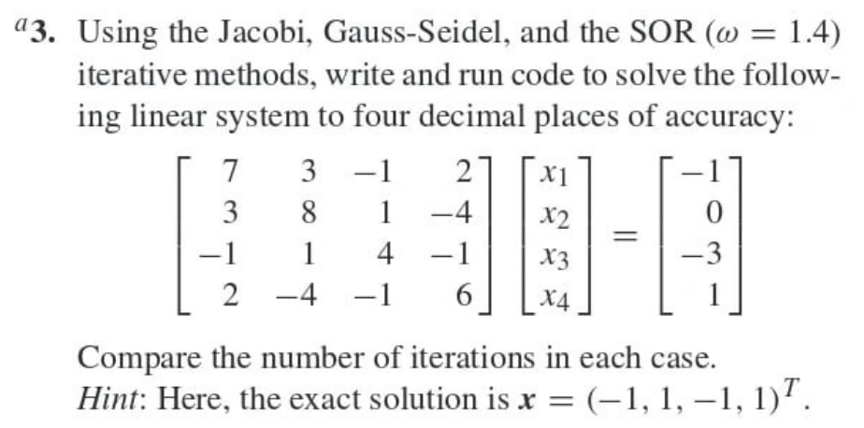
Results Computer Exercise 3 Input

Slide 20
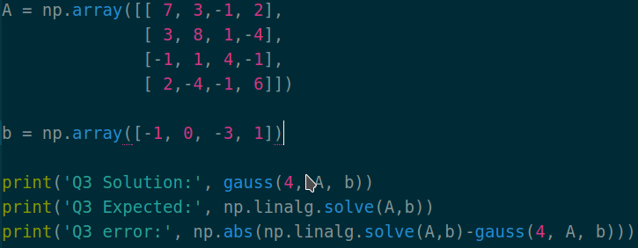
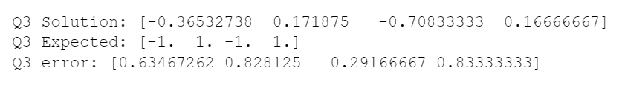
Results Computer Exercise 3
Gaussian Elimination Method
Script Input
Script Output

Slide 21
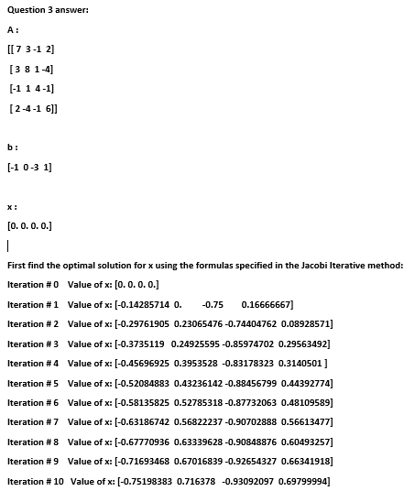
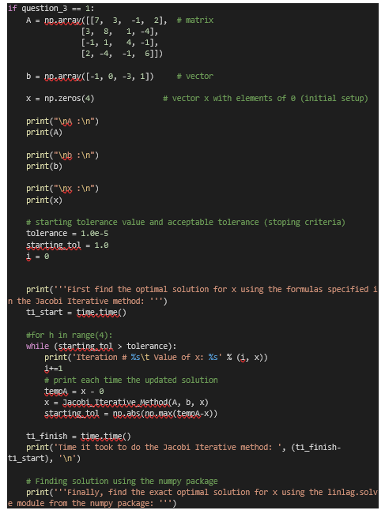
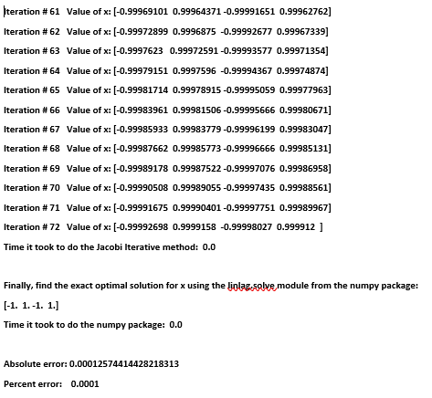
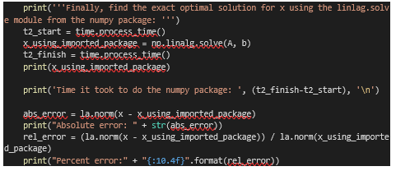
Results Computer Exercise 3
Script Input
Jacobi Iterative Method
Script Output

Slide 22
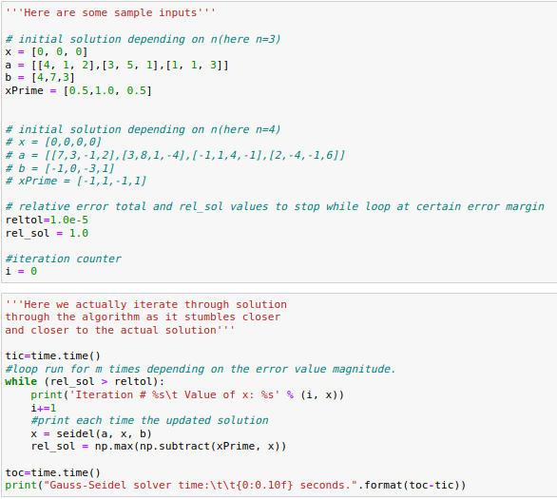
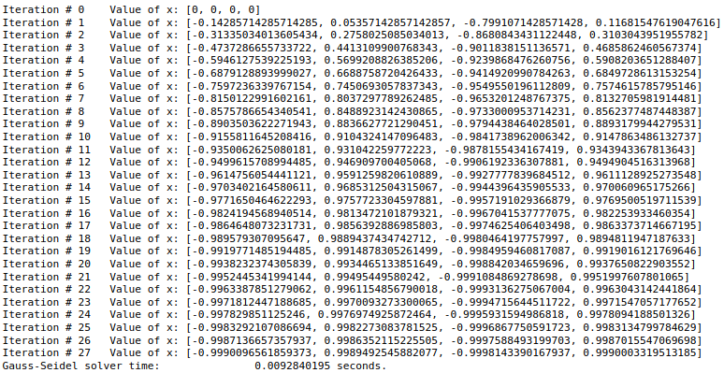
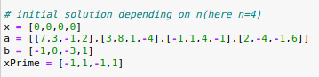
Results Computer Exercise 3
Gauss-Seidel Iterative Method
Script Input
Script Output

Slide 23
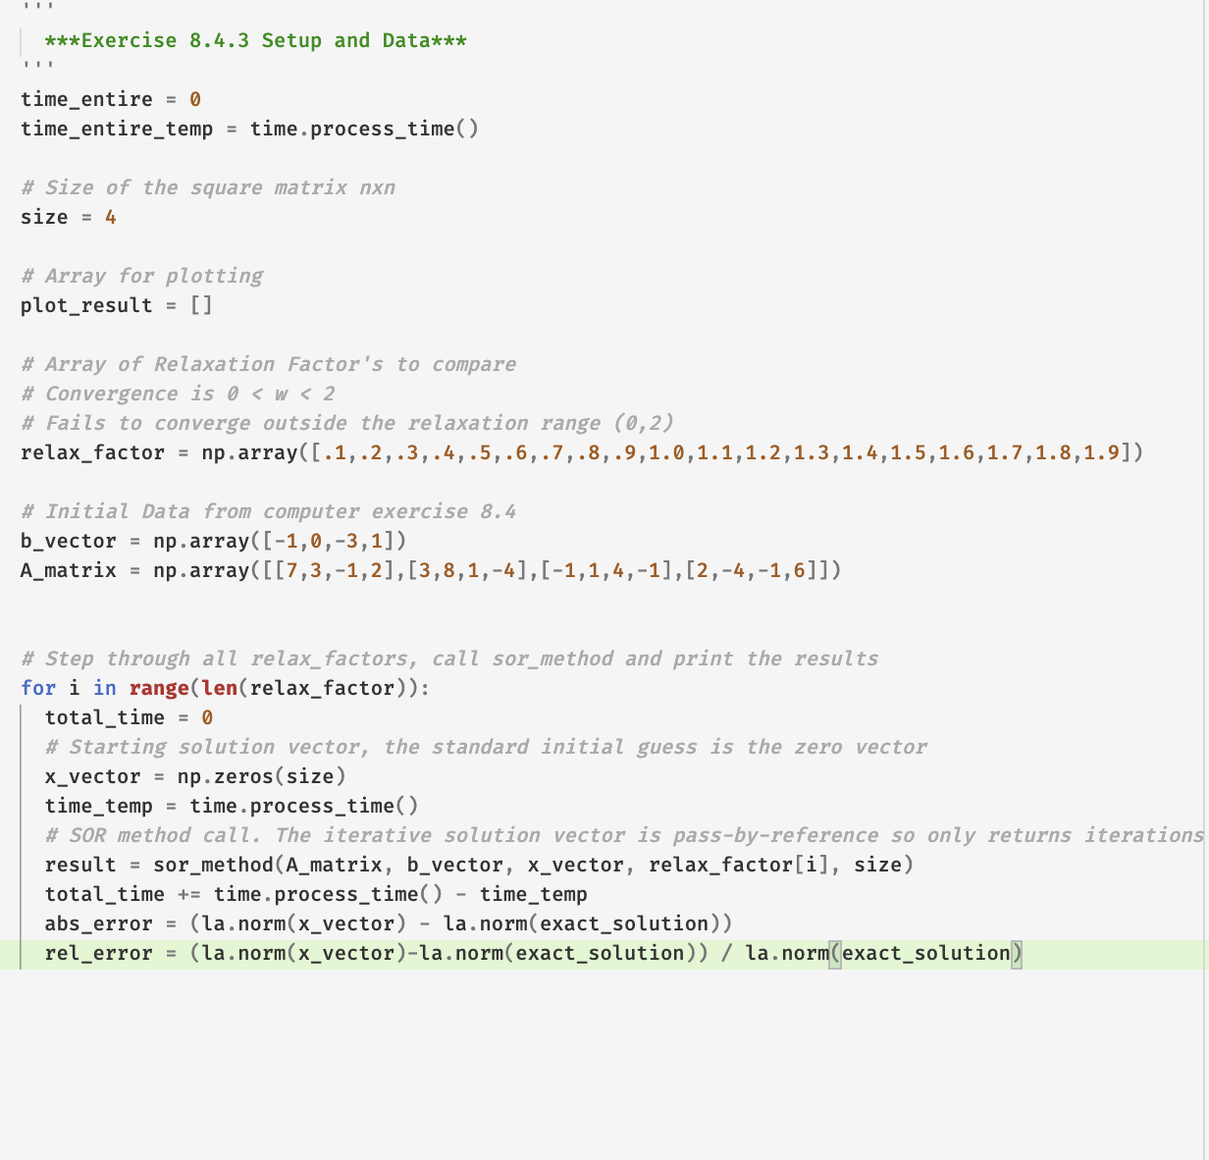
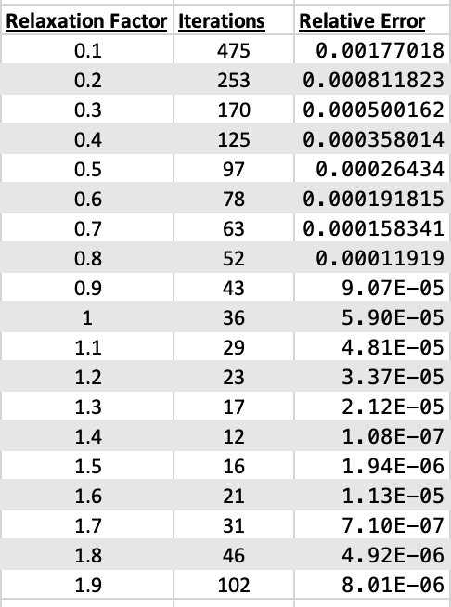
Results Computer Exercise 3
SOR Iterative Method
Script Input
Script Output

Slide 24
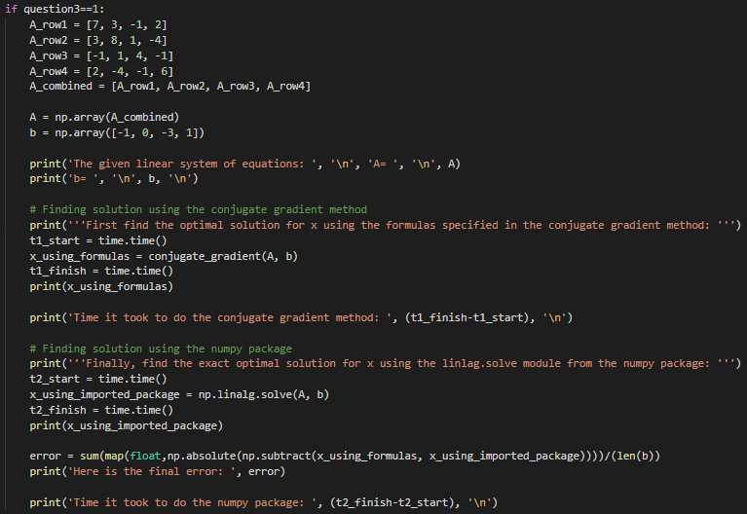
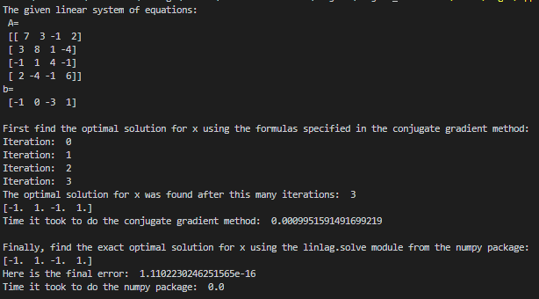
Results Computer Exercise 3
Conjugate Gradient Method
Script Input
Script Output

Slide 25
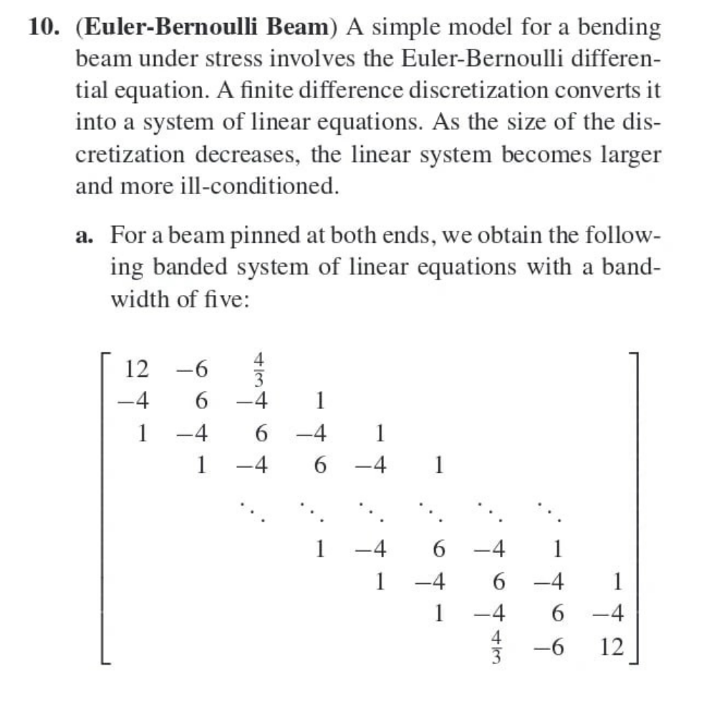
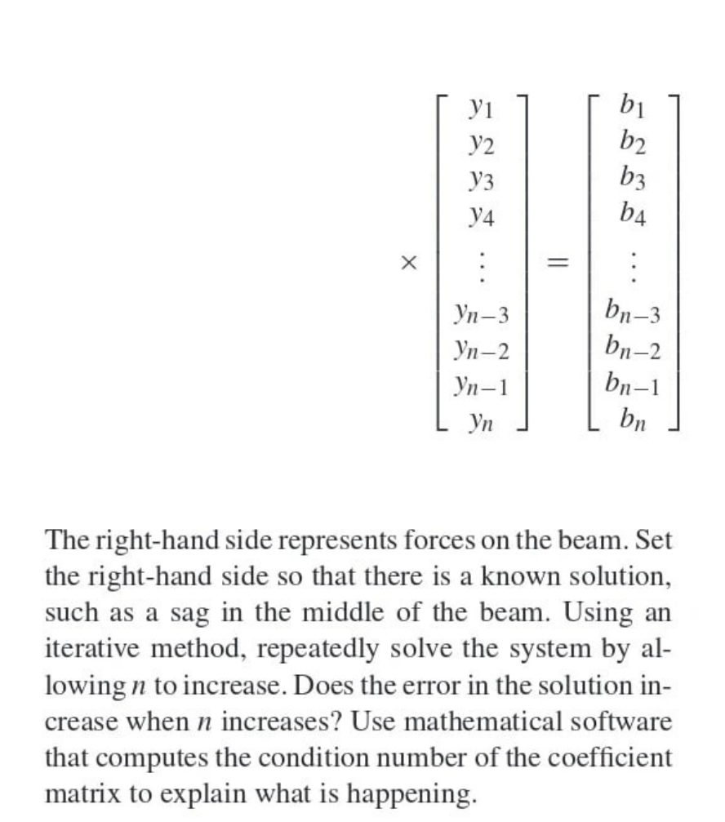
Results Computer Exercise 10a Input

Slide 26
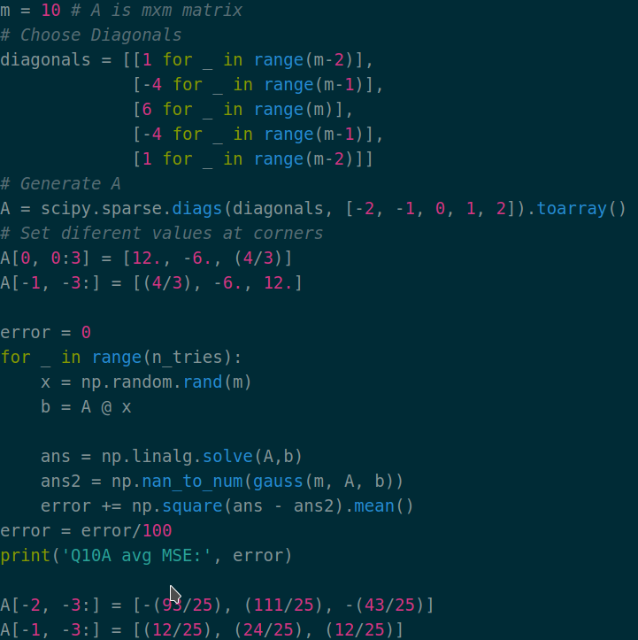
Results Computer Exercise 10a
Gaussian Elimination Method
Script Input
Script Output

Slide 27
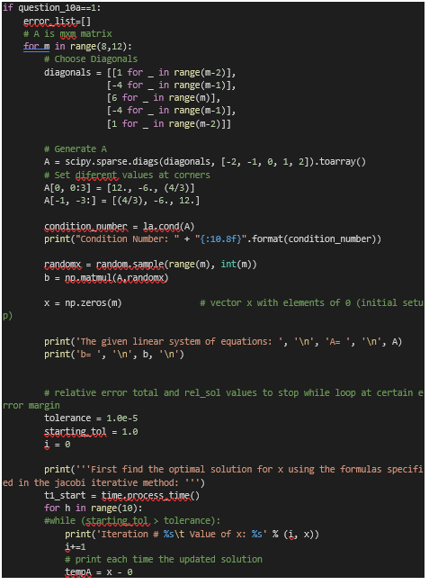
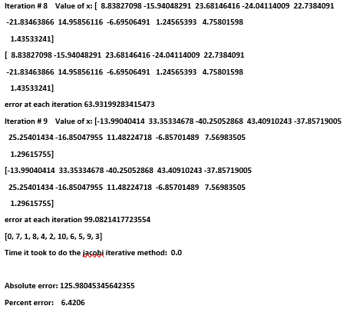
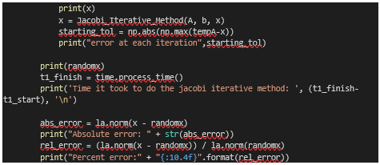
Results Computer Exercise 10a
Jacobi Iterative Method
Script Input
Script Output

Slide 28
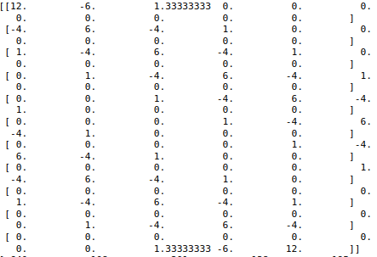
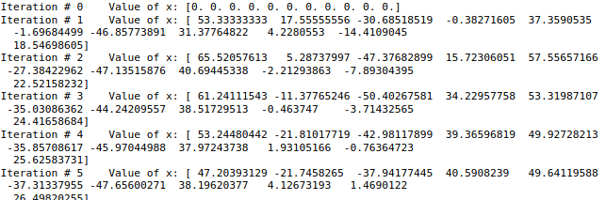
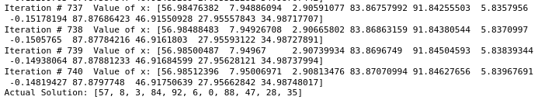
Results Computer Exercise 10a
Gauss-Seidel Iterative Method
Script Input
Script Output

Slide 29



Results Computer Exercise 10a
SOR Iterative Method
Script Input
Script Output

Slide 30



Results Computer Exercise 10a
Conjugate Gradient Method
Script Input
Script Output

Slide 31


Results Computer Exercise 10b

Slide 32


Results Computer Exercise 10b
Gaussian Elimination Method
Script Input
Script Output

Slide 33



Results Computer Exercise 10b
Jacobi Iterative Method
Script Input
Script Output

Slide 34



Results Computer Exercise 10b
Gauss-Seidel Iterative Method
Script Input
Script Output

Slide 35



Results Computer Exercise 10b
SOR Iterative Method
Script Input
Script Output

Slide 36



Results Computer Exercise 10b
Conjugate Gradient Method
Script Input
Script Output

Slide 37




Comparison of the Methods Computer Exercise 10a

Slide 38
Conclusion
It has been proven that all of five of these distinct methods are able to solve the same problem, with differences that help each method standout in different scenarios
The Gaussian Elimination method is a simpler version of solving a system of equations.
But is inefficient for large, more complicated systems.
The Jacobi method is efficient for square matrices that are diagonally dominant. And with an approximation in mind.
The parallel nature of this algorithm cuts down processing time according to the parallel capacity of the computational system.
The Gauss-Seidel Method is almost entirely similar to The Jacobi Method, except for one aspect; when the first element of the kth vector iteration is solved for.
This new element sacrifices the parallel nature of The Jacobi method in order to achieve greater accuracy per iteration..
The SOR method is a copy of Gauss-Seidel (and another variation of Jacobi) that introduces a new parameter.
Parameter: the ω variable which seeks to amplify the rate at which each iteration closes on the actual solution.
We potentially speed things up by multiplying each iteration by a scalar such that each new vector’s magnitude is amplified once calculated.
The Conjugate Gradient Method was written to combat the problem of the convergence of the optimum being slow for larger matrices.

Slide 39
Bibliography
[1] Black, Noel; Moore, Shirley; and Weisstein, Eric W. "Jacobi Method." From MathWorld--A Wolfram Web Resource. https://mathworld.wolfram.com/JacobiMethod.html
[2] Karunanithi, S., Gajalakshmi, N., Malarvizhi, M., & Saileshwari, M. (2018). A Study on Comparison of Jacobi, GaussSeidel and Sor Methods for the Solution in System of Linear Equations, 56(4), 1-9.
[3] Lynch, Deirdre. “2.5.2/Gauss-Seidel Method and SOR.” Numerical Analysis, by Tim Sauer, Pearson, Boston, Massachusetts, 2012, pp. 108–109.
[4] Saad, Yousef (2003). Iterative Methods for Sparse Linear Systems (2nd ed.). SIAM. p. 414
[5] Strong, David M. “Iterative Methods for Solving Ax = b - Jacobi's Method.” Iterative Methods for Solving Ax = b - Jacobi's Method | Mathematical Association of America, July 2005, www.maa.org/press/periodicals/loci/joma/iterative-methods-for-solving-iaxi-ibi-jacobis-method.
[6] Rambo, Mikeq. “The Conjugate Gradient Method for Solving Linear Systems of Equations.” Http://Math.stmarys-Ca.edu/, 2016, math.stmarys-ca.edu/wp-content/uploads/2017/07/Mike-Rambo.pdf.

Slide 40
Bibliography
[7] Cheney, E. W., and David Kincaid. Numerical Mathematics and Computing. Brooks/Cole, Cengage Learning, 2013.
[8] Dongarra, Jack. “ The Successive Overrelaxation Method.” The Successive Overrelaxation Method, 1995, www.netlib.org/linalg/html_templates/node15.html.
[9] Ford, William. “Relaxation Parameter.” Relaxation Parameter - an Overview, www.sciencedirect.com/topics/computer-science/relaxation-parameter.
[10] Katopodes, Nikolas D. “Over-Relaxation.” Over-Relaxation - an Overview | ScienceDirect Topics, www.sciencedirect.com/topics/engineering/over-relaxation.
[11] Moler, Cleve. “What Is the Condition Number of a Matrix?” Cleve's Corner: Cleve Moler on Mathematics and Computing, The MathWorks, Inc., 17 July 2017, blogs.mathworks.com/cleve/2017/07/17/what-is-the-condition-number-of-a-matrix/.
[12] Petersdorff, Tobias Von. Errors for Linear Systems. terpconnect.umd.edu/~petersd/460/linsysterrn.pdf.

Slide 41
Bibliography
[13] Rapp, Bastian E. “Numerical Methods for Linear Systems of Equations.” Microfluidics: Modelling, Mechanics and Mathematics, Elsevier, 6 Dec. 2016, www.sciencedirect.com/science/article/pii/B9781455731411500253.
[14] “Relaxation Method.” Relaxation Method - Encyclopedia of Mathematics, encyclopediaofmath.org/wiki/Relaxation_method.
[15] Strong, David M. “Iterative Methods for Solving Ax = b - The SOR Method.” Iterative Methods for Solving Ax = b - The SOR Method | Mathematical Association of America, www.maa.org/press/periodicals/loci/joma/iterative-methods-for-solving-iaxi-ibi-the-sor-method.
[16] “Successive Overrelaxation Method.” From Wolfram MathWorld, mathworld.wolfram.com/SuccessiveOverrelaxationMethod.html.

